Slide 1
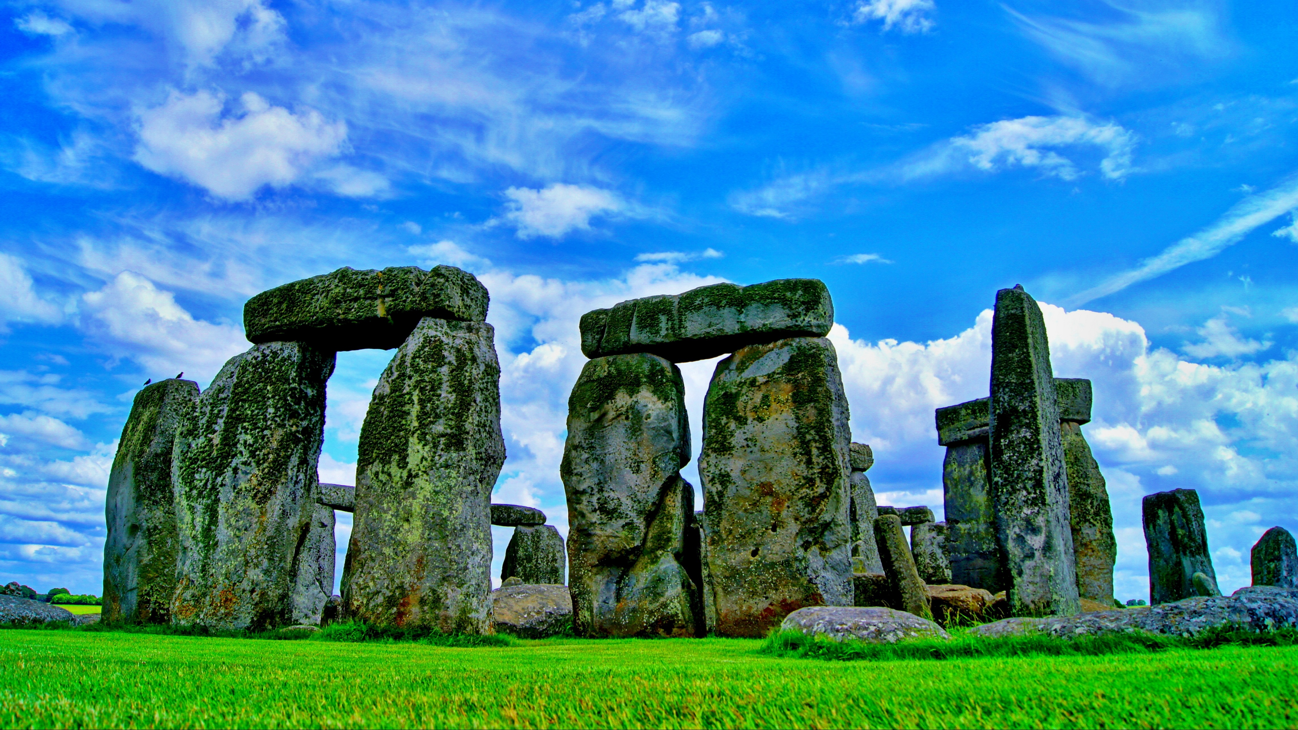
British Culture
梁梅
吳明軒
游良賢
吳景翰

Slide 2
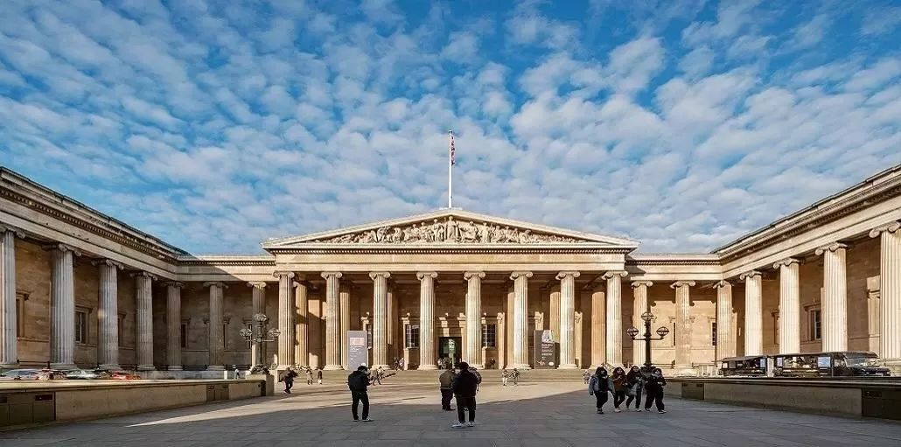
clothing

Slide 3
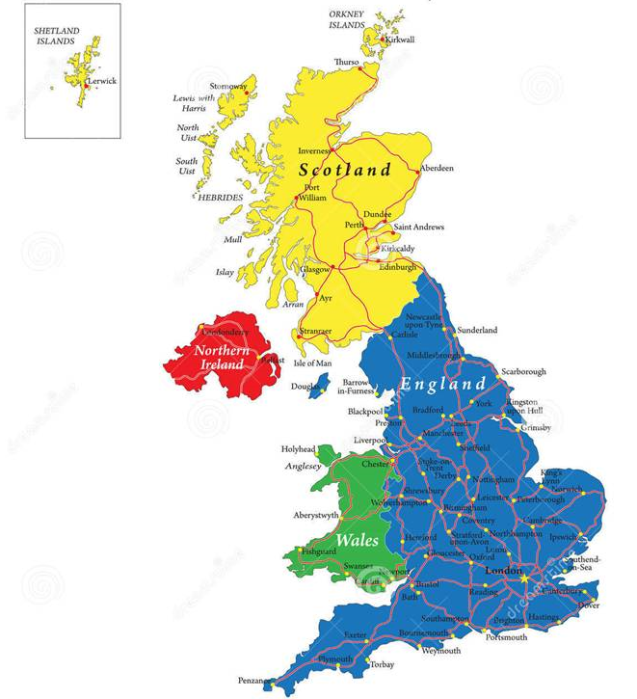
What is your impression of traditional British clothing?
Notes:
What do you think about the traditional dress of British?

Slide 4
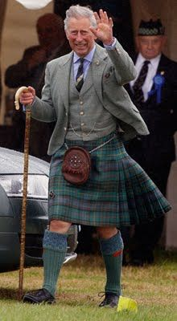
This kind of skirt is called Kilt
Men wear skirts in a tartan pattern.

Slide 5
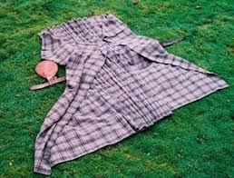
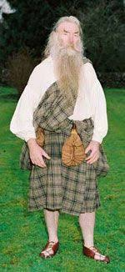
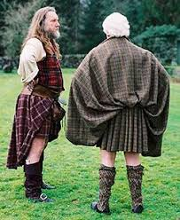
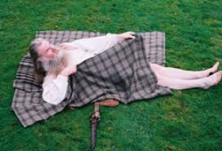
What is Kilt?
■made by one piece of cloth
■ knee-length skirt
■ with pleats at the back
Notes:
A kilt is made by one piece of cloth, it is a type of knee-length skirt with pleats at the back, originating in the traditional dress of Gaelic men and boys in the Scottish Highlands.

Slide 6
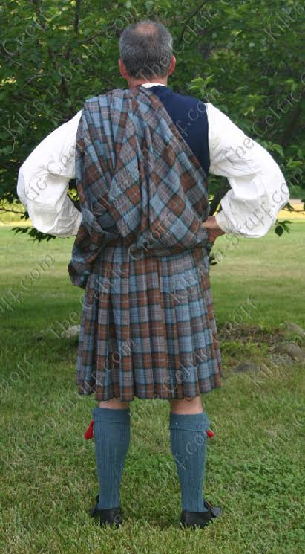
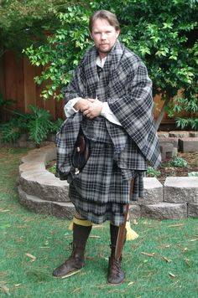
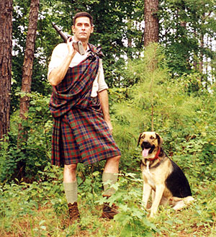
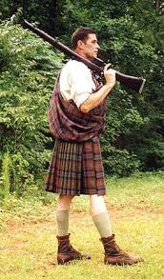
Kilts function
■a barrier between the rain and skin.
■ easily removed and spread out
■ freedom of movement
■ its pleat helped protect the soldier
https://www.youtube.com/watch?v=vEmES4-7kvc
https://www.scotland.com/blog/the-scottish-kilt-a-brief-history/
Notes:
The kilt is more than just a covering. It allowed those who wore it to move much more freely, especially in the Highlands of Scotland where the weather can become very damp. With its tight weave of strong wool, it created a barrier between the rain and skin. When the armies of the past were fighting in Scotland, the kilt with its pleat helped protect the soldier much like armor would. When the nights became cold, this garment was easily removed and spread out to create a blanket to keep the person who owned it warm. Lastly, if the army needed to move with a much quicker force, the garment could be easily removed, thus allowing the soldier more freedom of movement.

Slide 7
Notes:
■ Kilt is originating in the traditional dress of Gaelic men and boys in the Scottish Highlands.
It come from Highlands . is originating in the traditional dress of Gaelic men and boys in the Scottish Highlands.

Slide 8
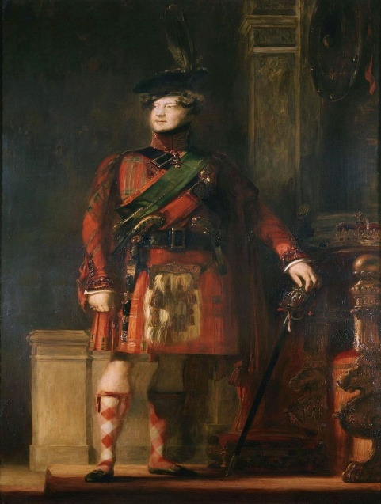
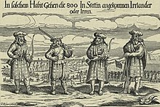
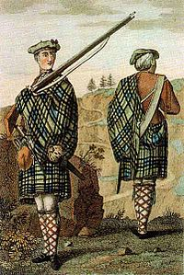
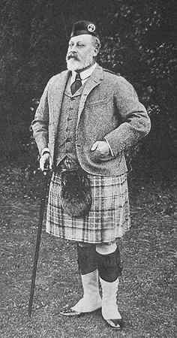
The history of the kilt
Celts wore the great kilts.
King George IV visited Scotland. He was the first British monarch that wore a kilt.
the 16th century
1822
great kilt
small kilt
1904
1743
The English army decided to adopt the kilts as the Highlander’s army uniform
King Edward VII wore a kilt.
Notes:
The history of the kilt stretches back to at least the end of the 16th century. The kilt first appeared as the belted plaid or great kilt, a full length garment whose upper half could be worn as a cloak draped over the shoulder, or brought up over the head as a hood. The small kilt or walking kilt (similar to the 'modern' kilt) did not develop until the late 17th or early 18th century, and is essentially the bottom half of the great kilt. as a kilt today was invented in the 1720s by Thomas Rawlinson, a Quaker from Lancashire The wearing of Scottish kilts was common during the 1720s, when the British military used them as their formal uniforms. The knee-length kilt, similar to the modern kilt of today, did not develop until the late 17th or early 18th century.

Slide 9
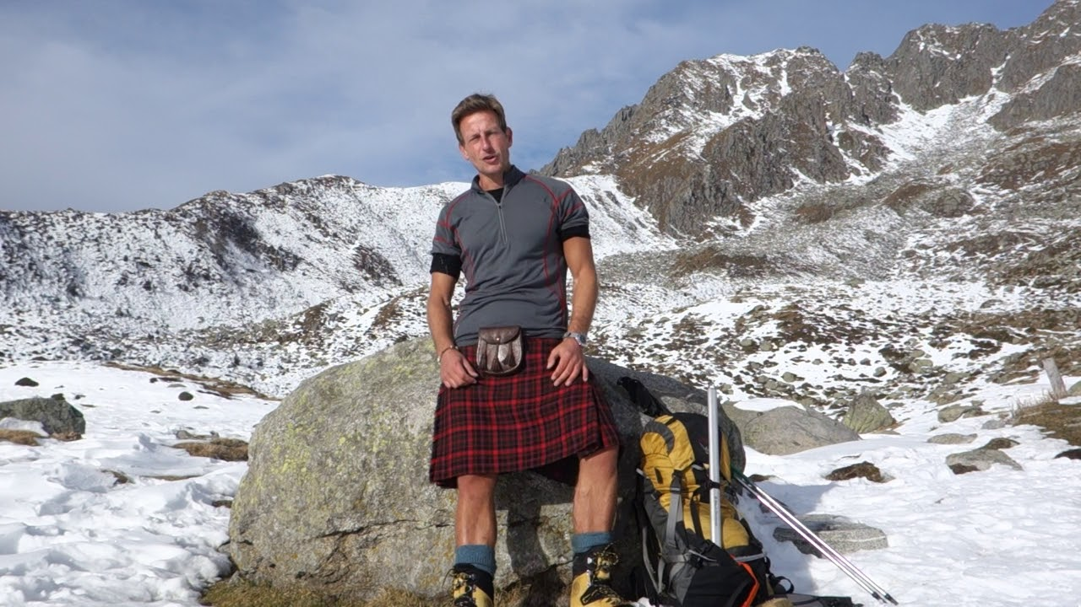
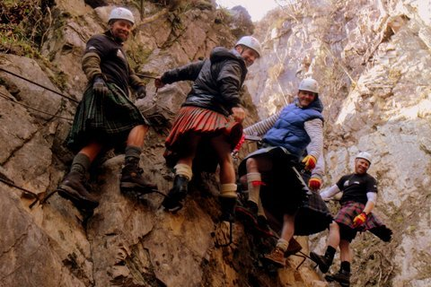
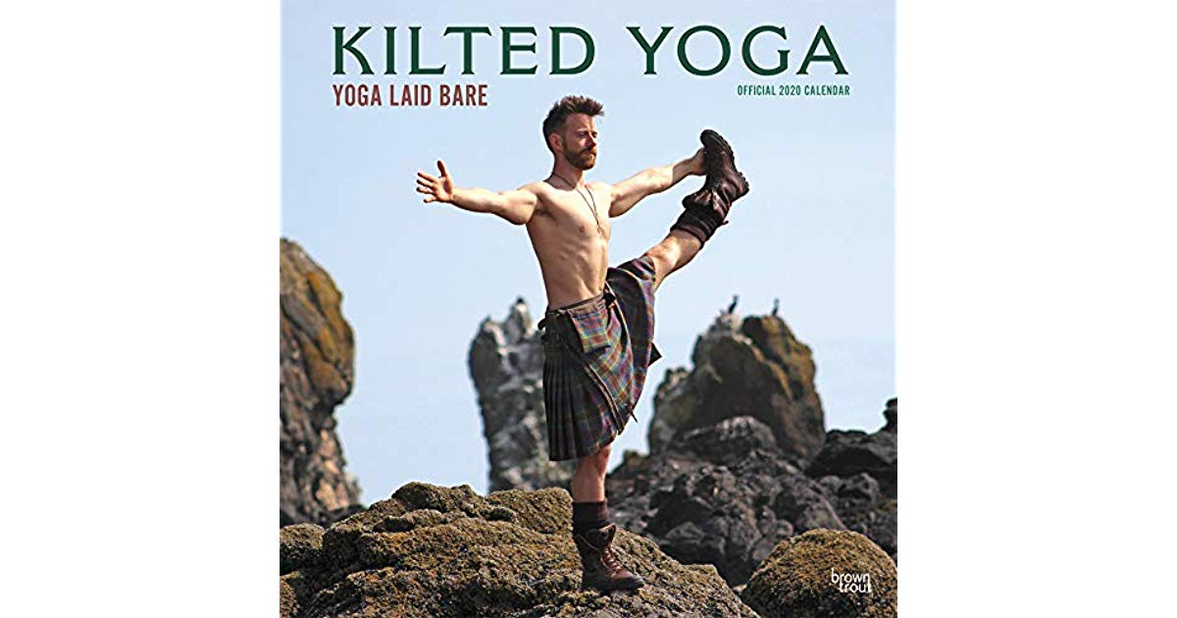
Reasons to Wear a Kilt
■ Freedom of movement
■ Ventilation
■ Ease of access
■ Scottish pride
The Kilted Climber
https://www.youtube.com/watch?v=Ll1Fx4QemCU
Notes:
Now there are many people still prefer to wear kilts to do actives. Because of they consider the kilts have

Slide 10
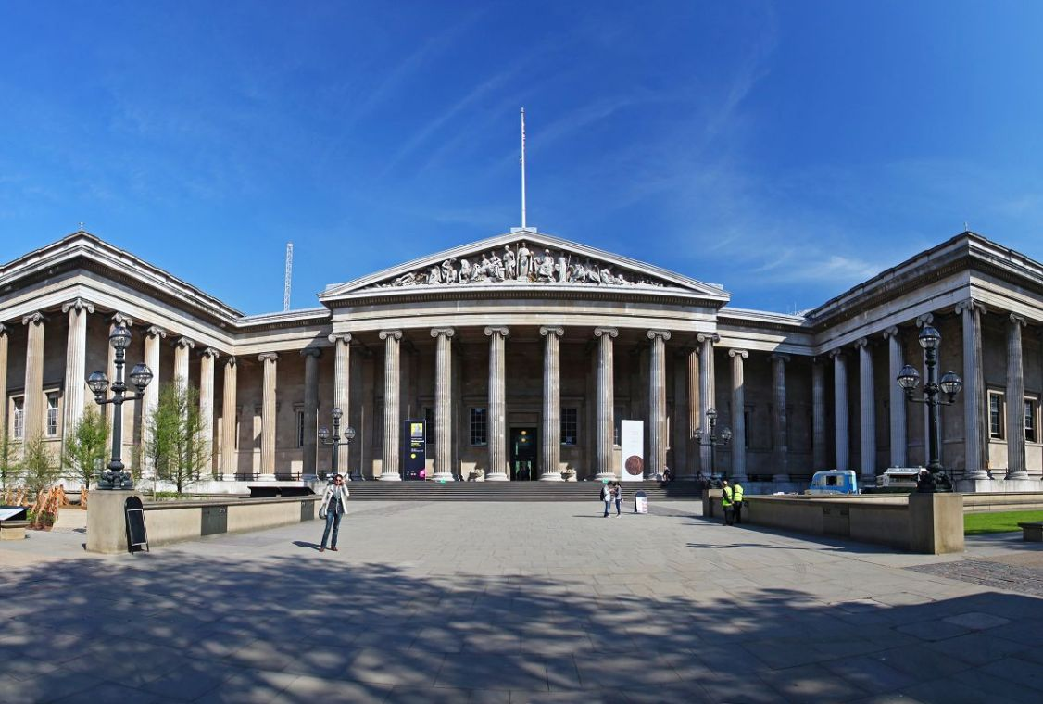
Art Culture

Slide 11
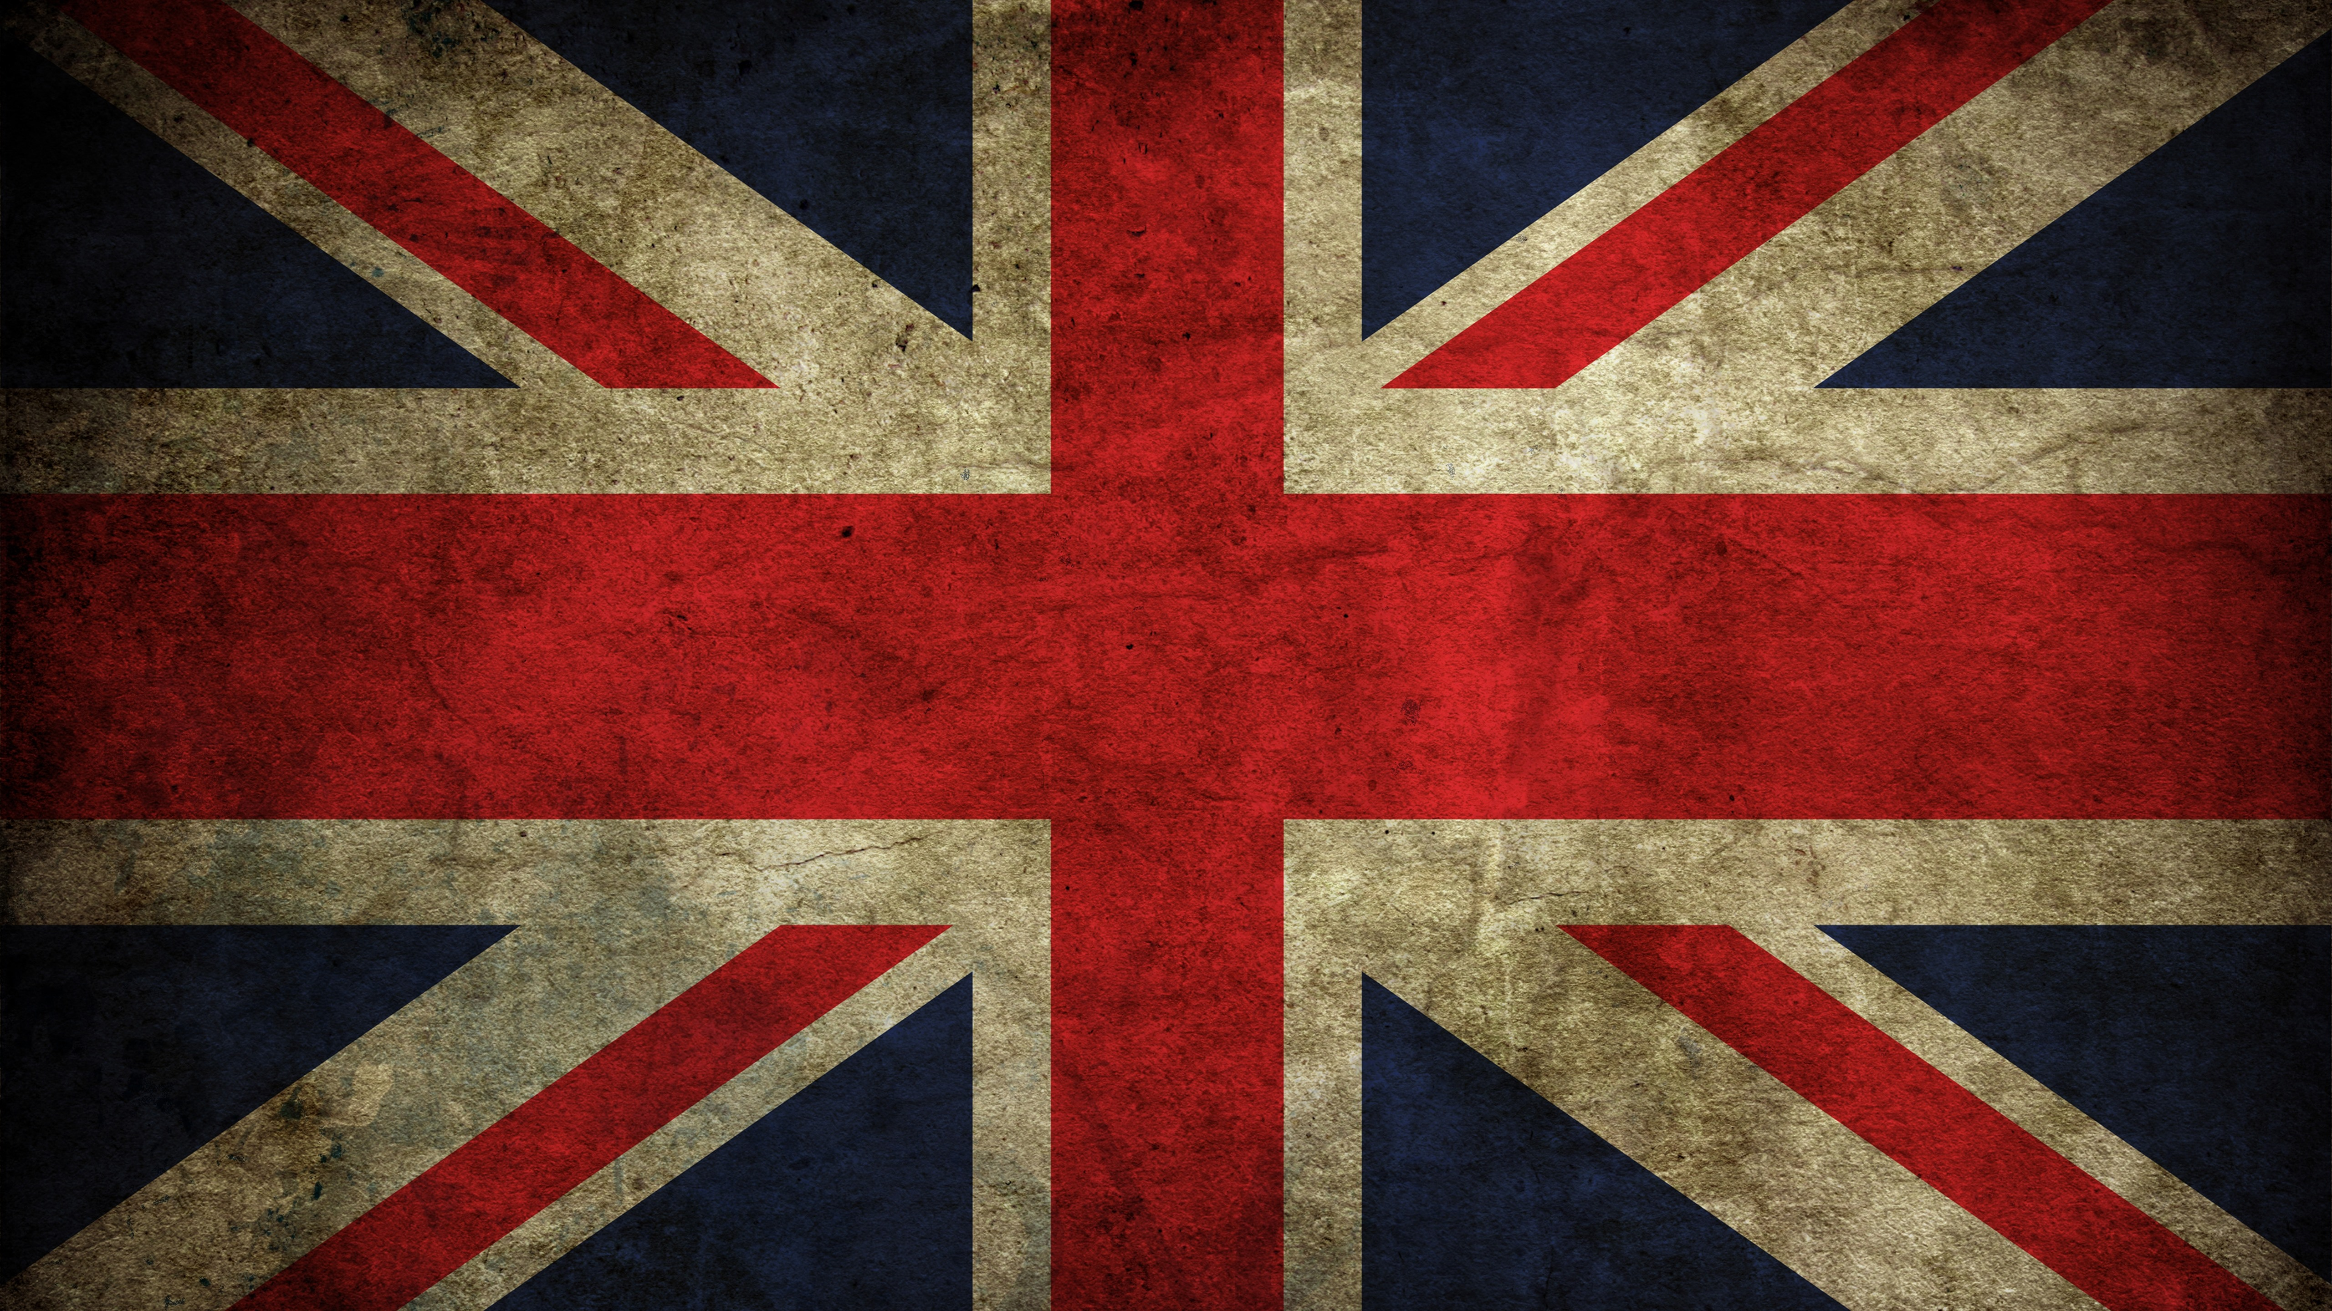
English Literature
Ancient
Renaissance
Romanticism
Early 20th Century
Middle Ages
Neoclassical
Victorian
After WWII

Slide 12
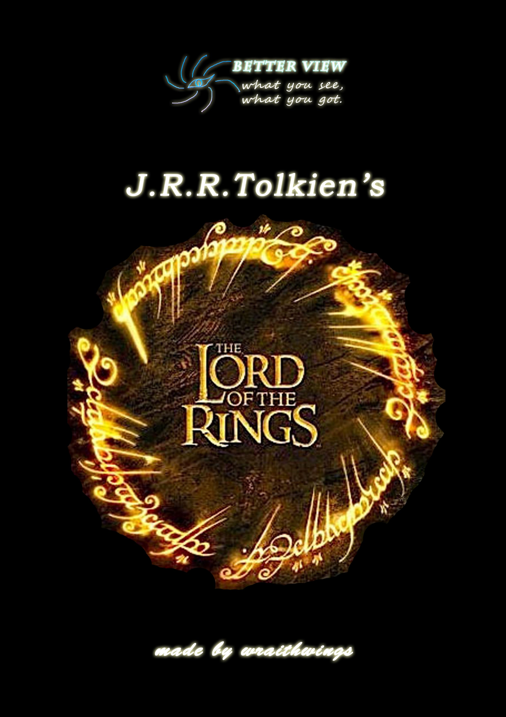
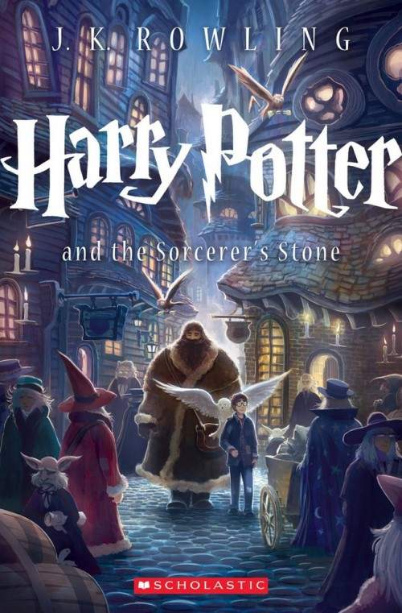
Famous works
The Lord of the Rings
Harry Potter

Slide 13
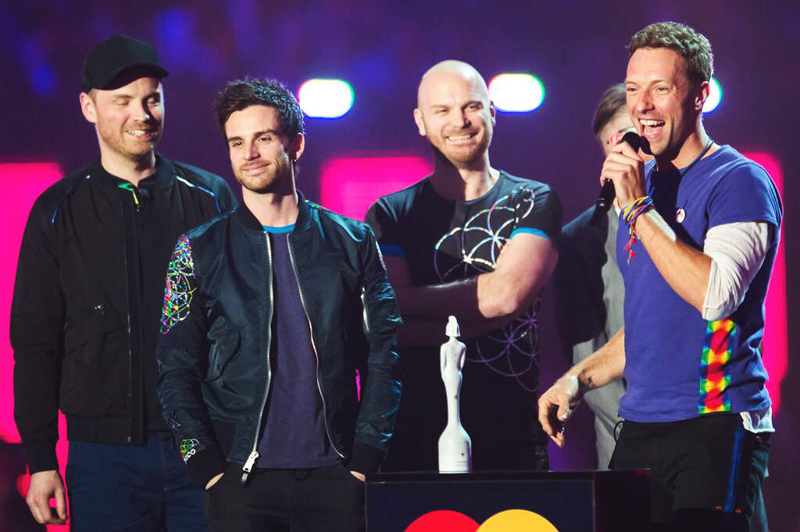
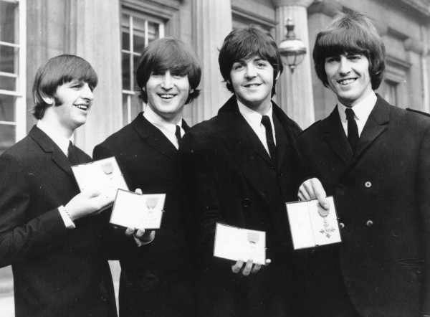
Music
Folk Music
classical music
Early British Pop
Modern British Pop

Slide 14
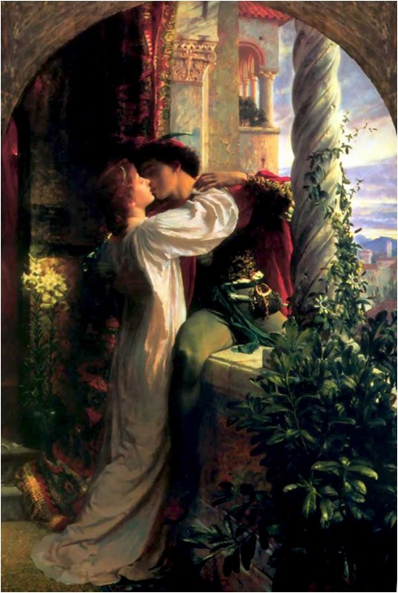
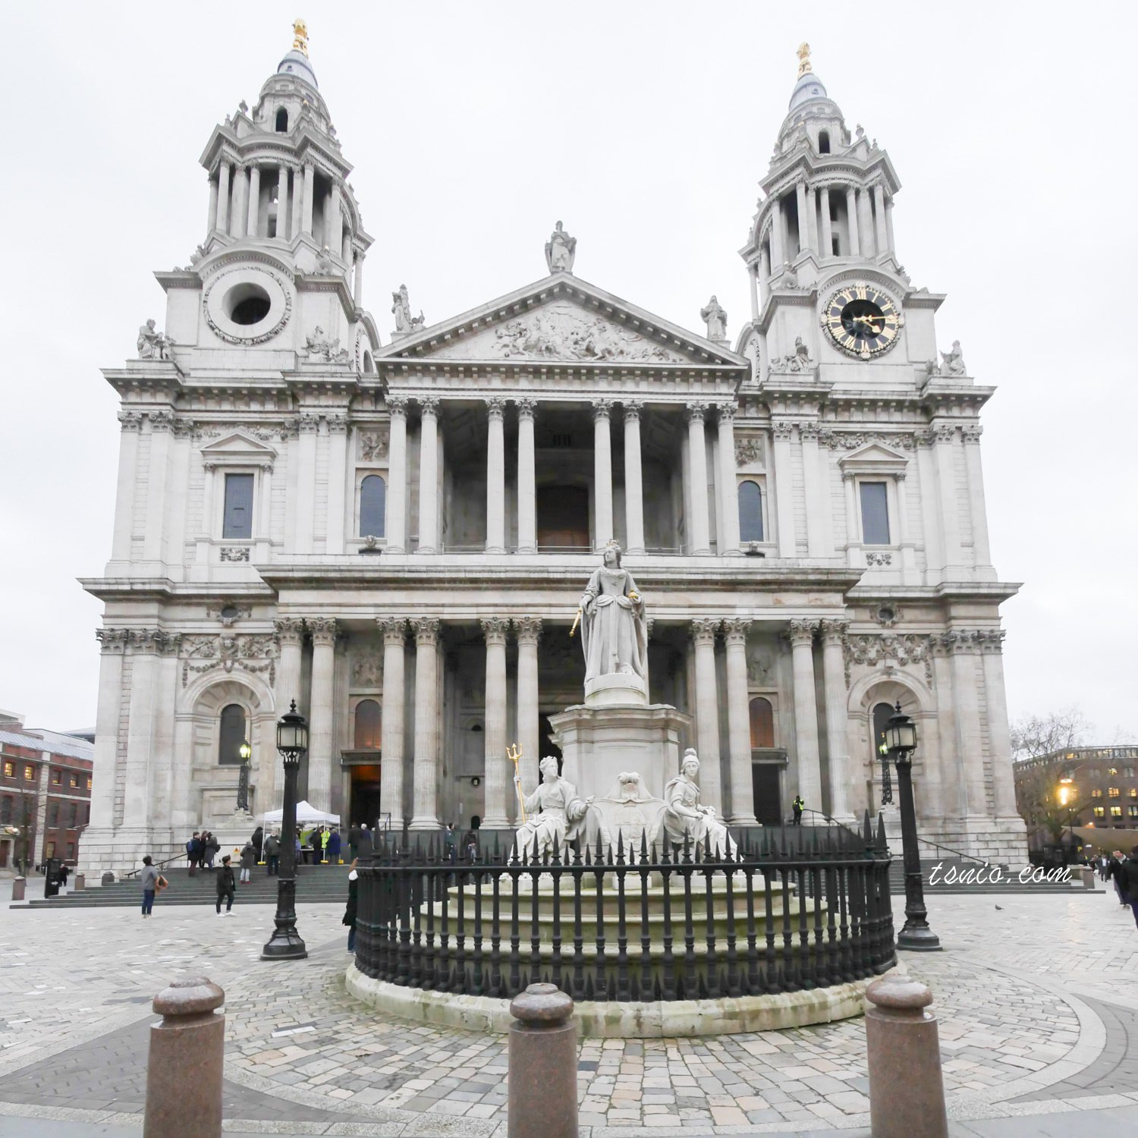
Drama

Slide 15
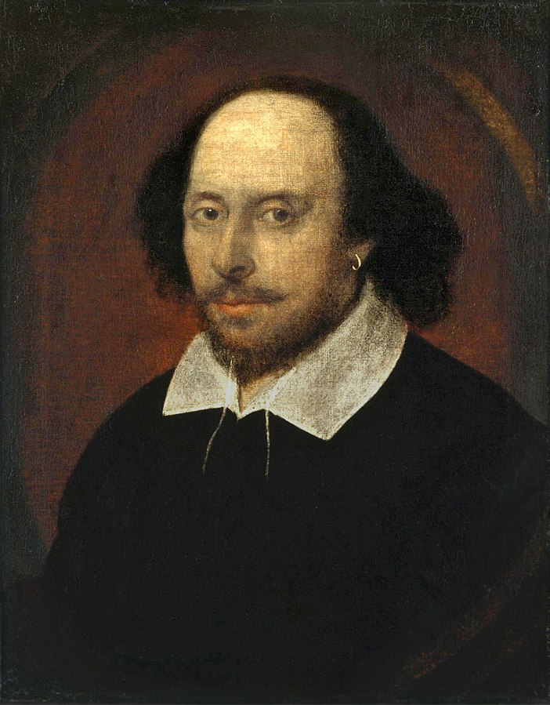
William Shakespeare
Romeo and Juliet
Hamlet
Macbeth
King Lear
Othello
A Midsummer Night's Dream

Slide 16
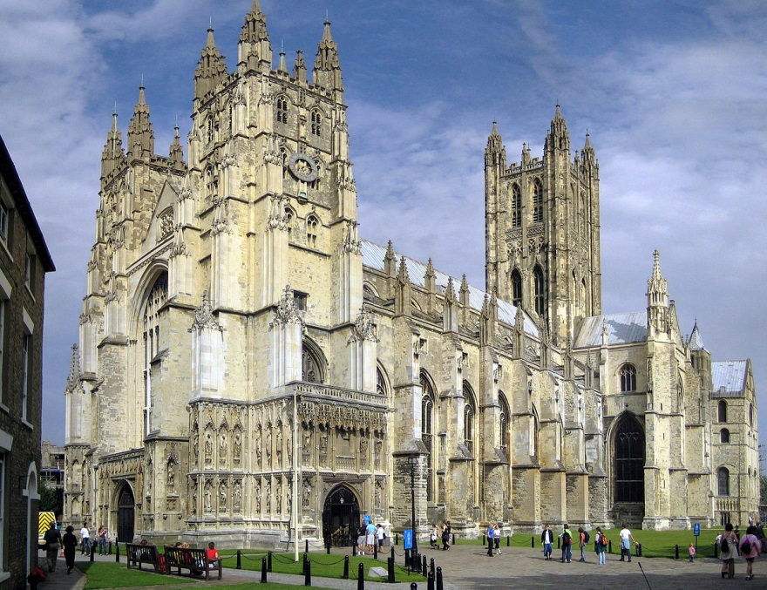
Religion

Slide 17


Slide 18
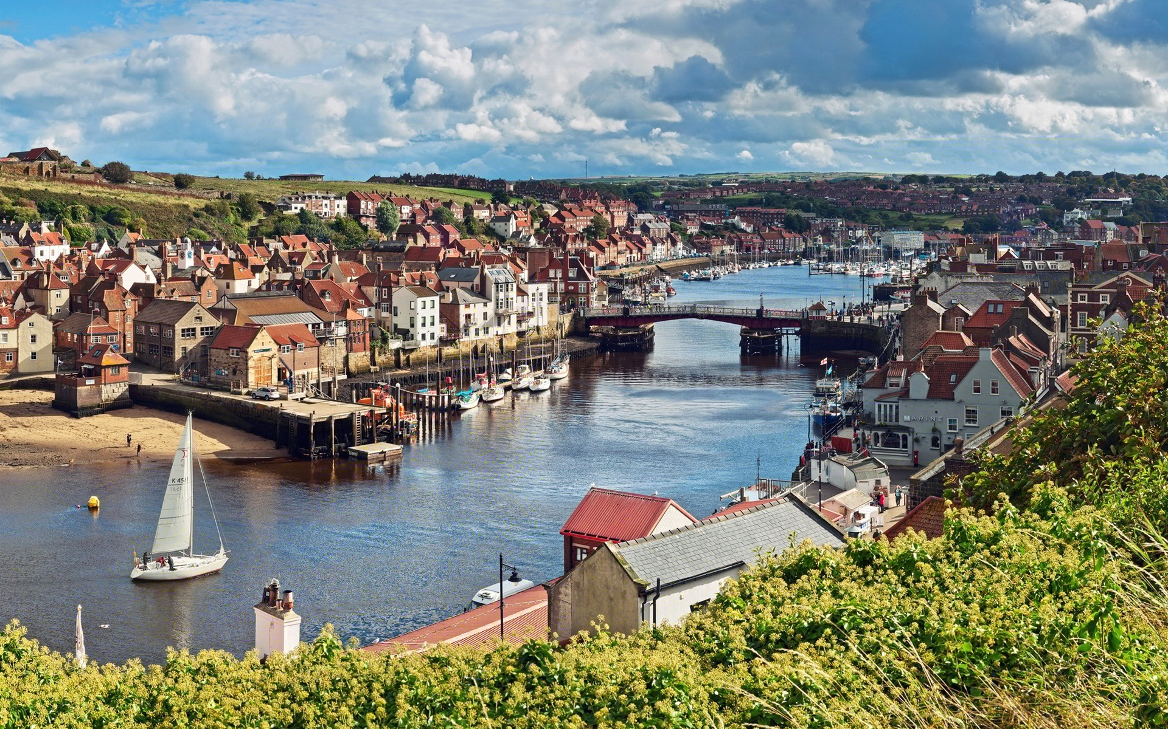
Culture

Slide 19

communication styles

Slide 20
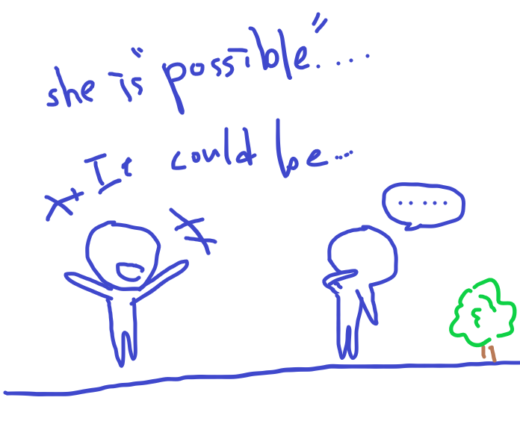

Slide 21
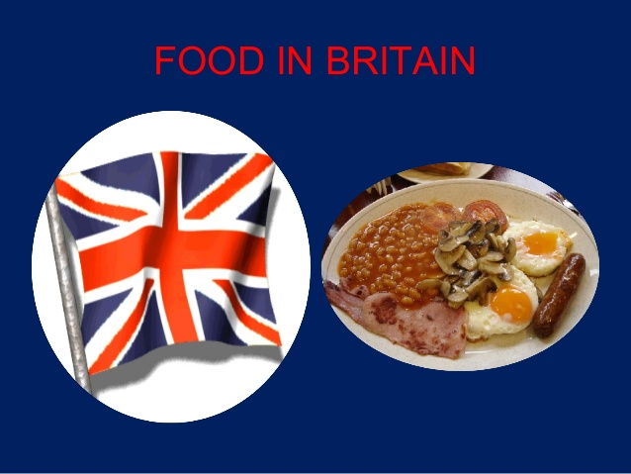

Slide 22
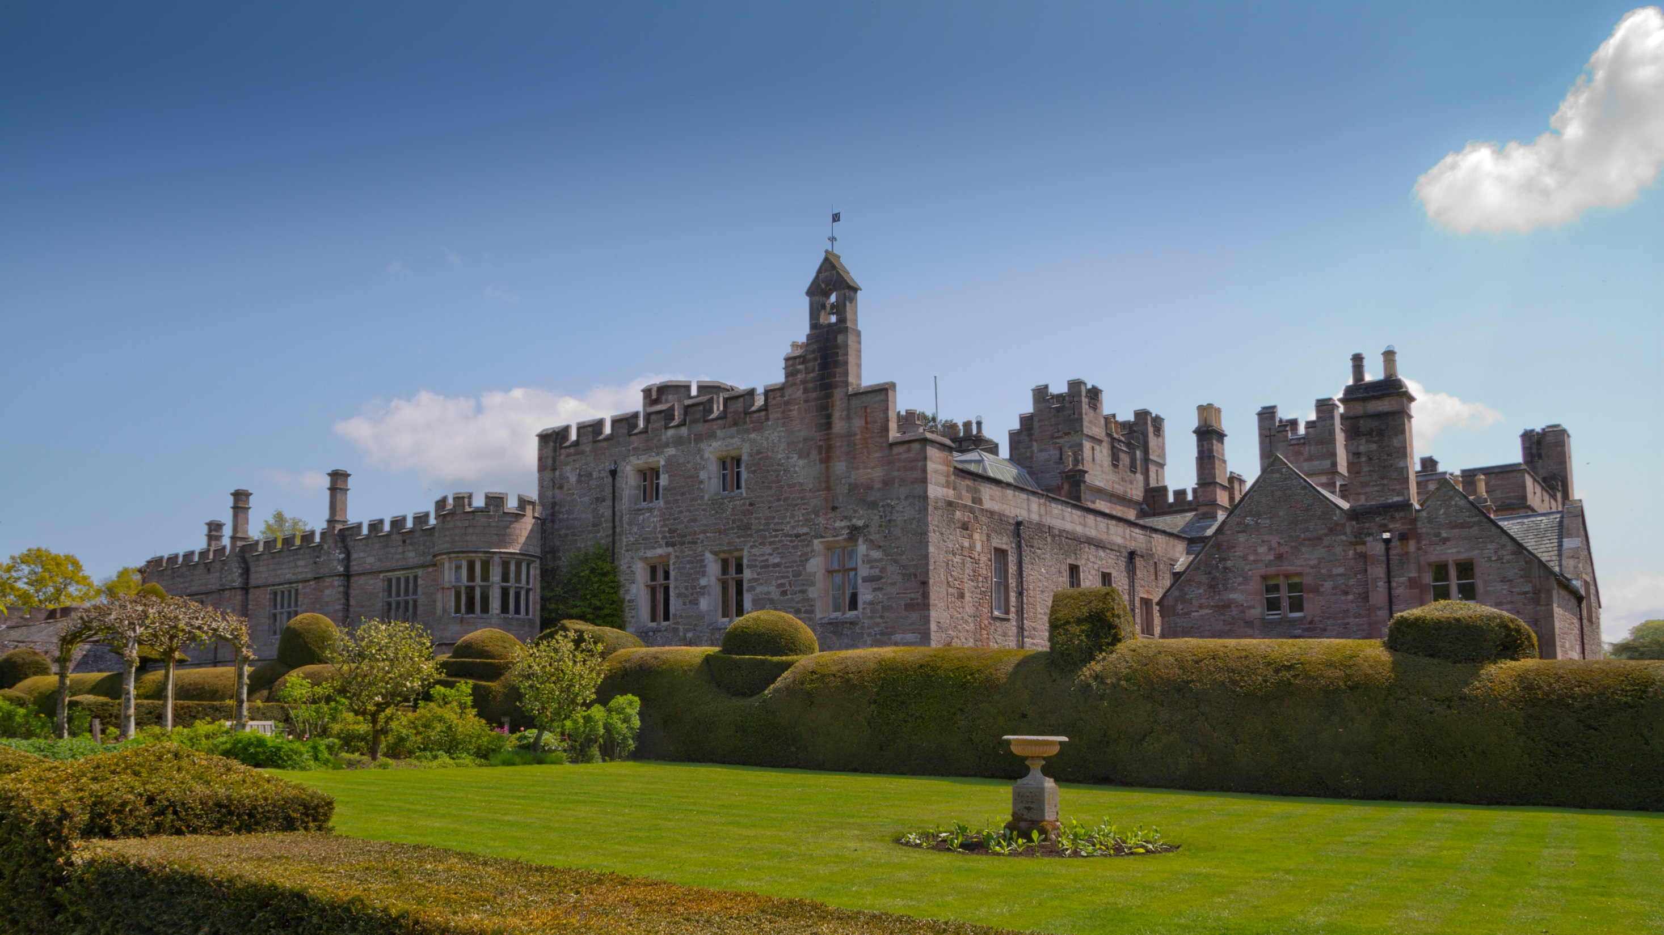
Afternoon Tea

Slide 23
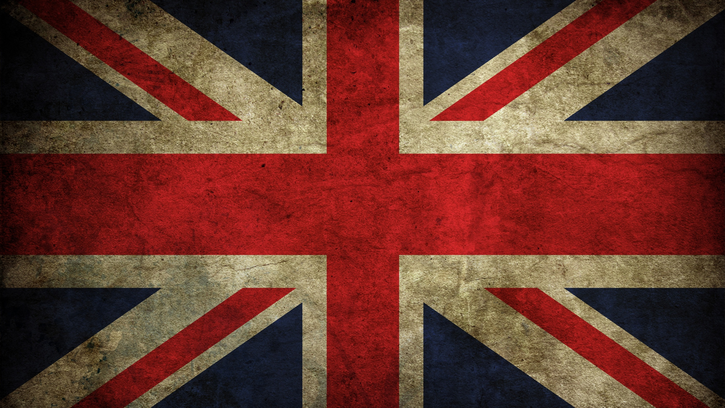
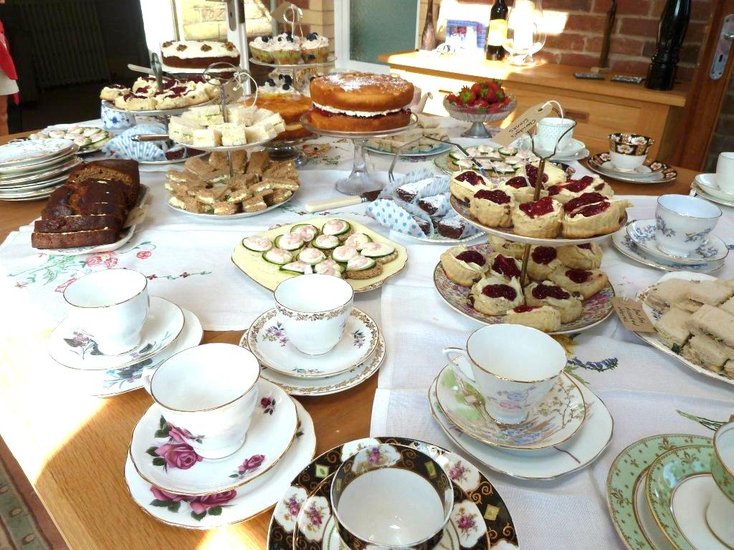
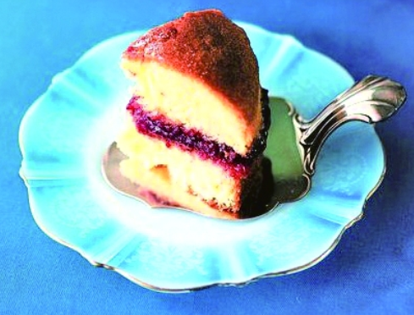
Tea Party

Slide 24
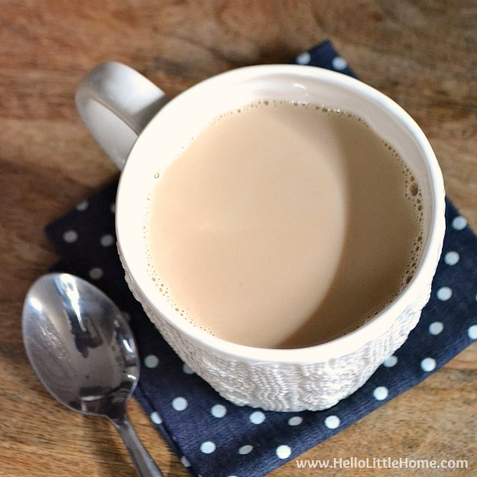
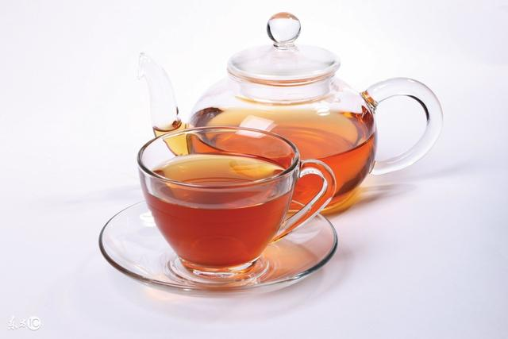
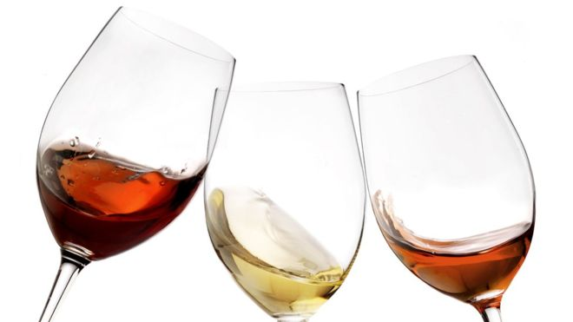
Common Sense
Time:15:30~16:30

Slide 25
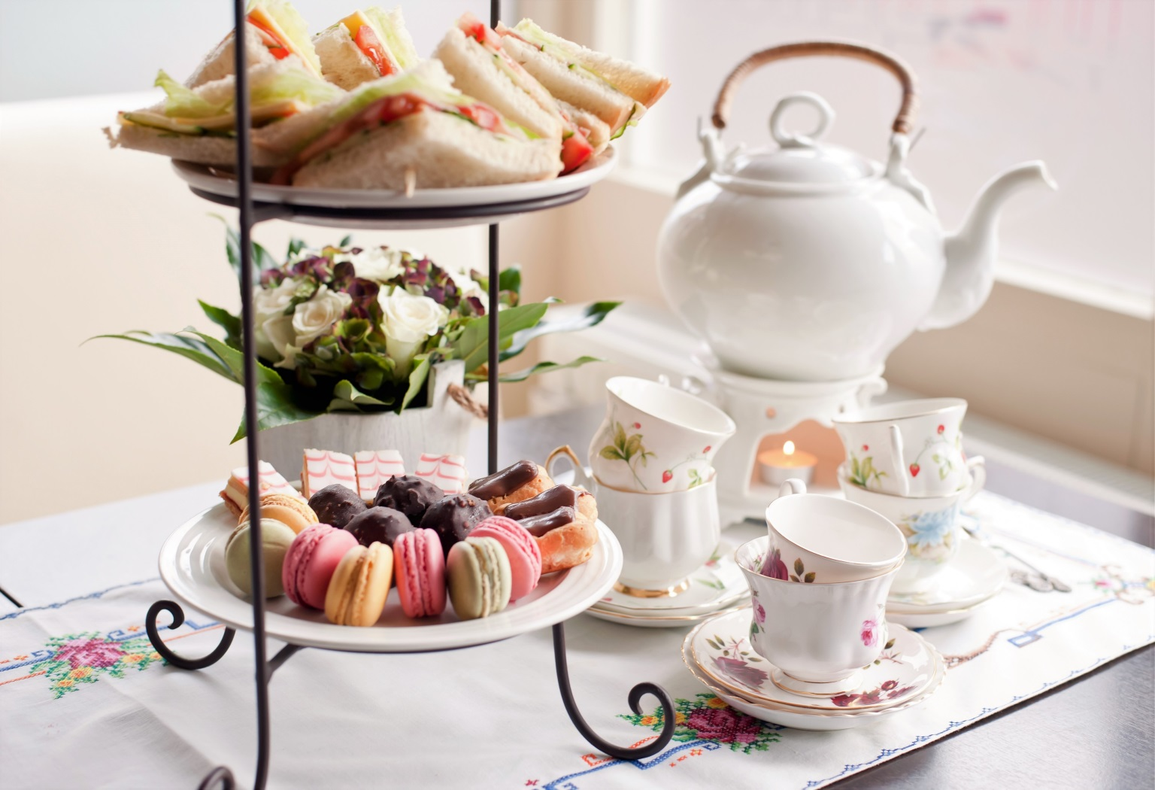
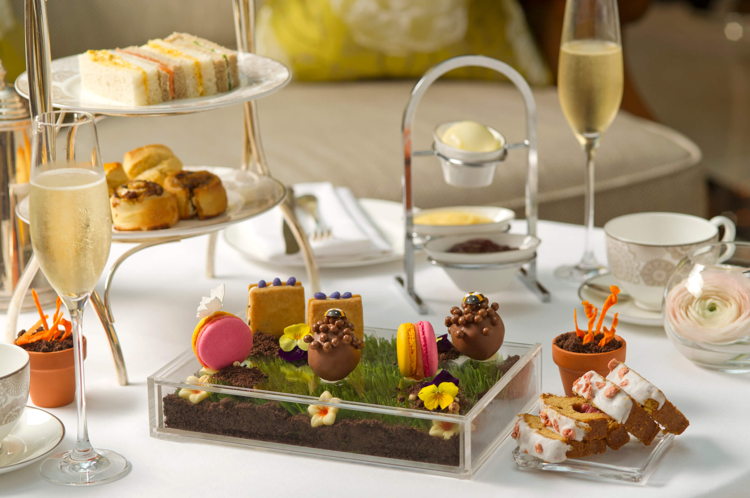
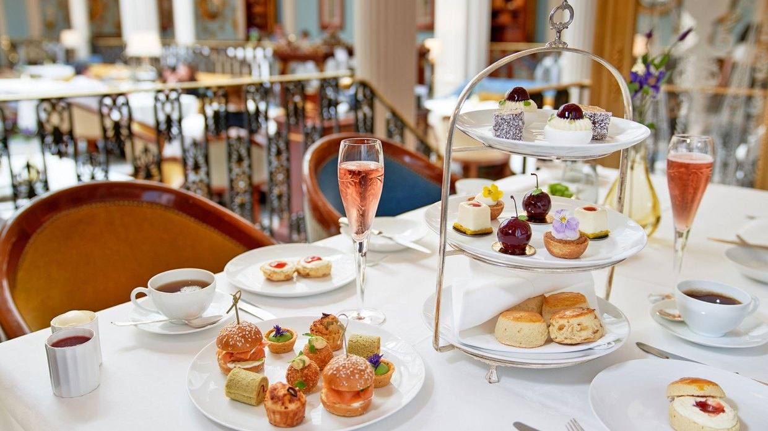
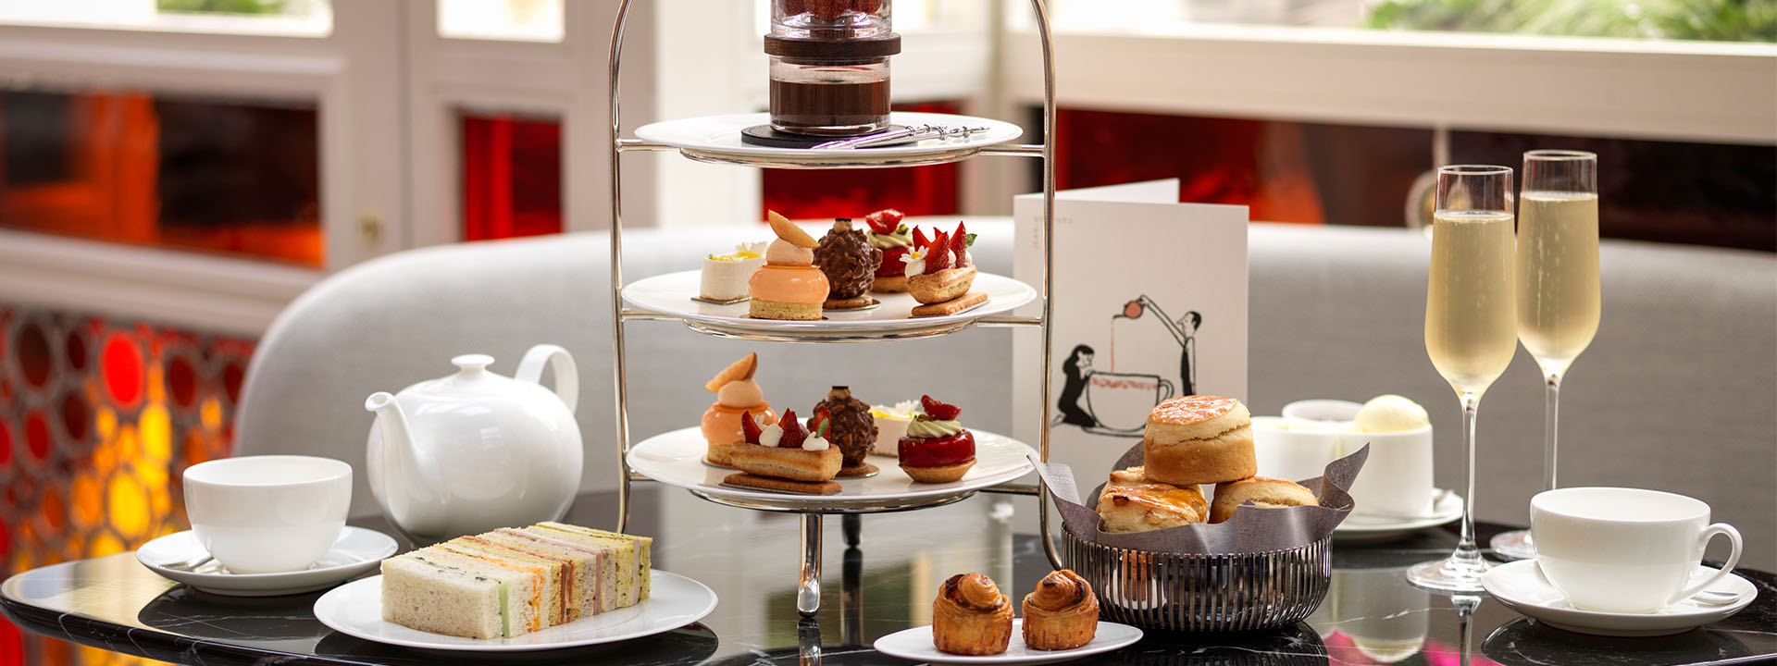
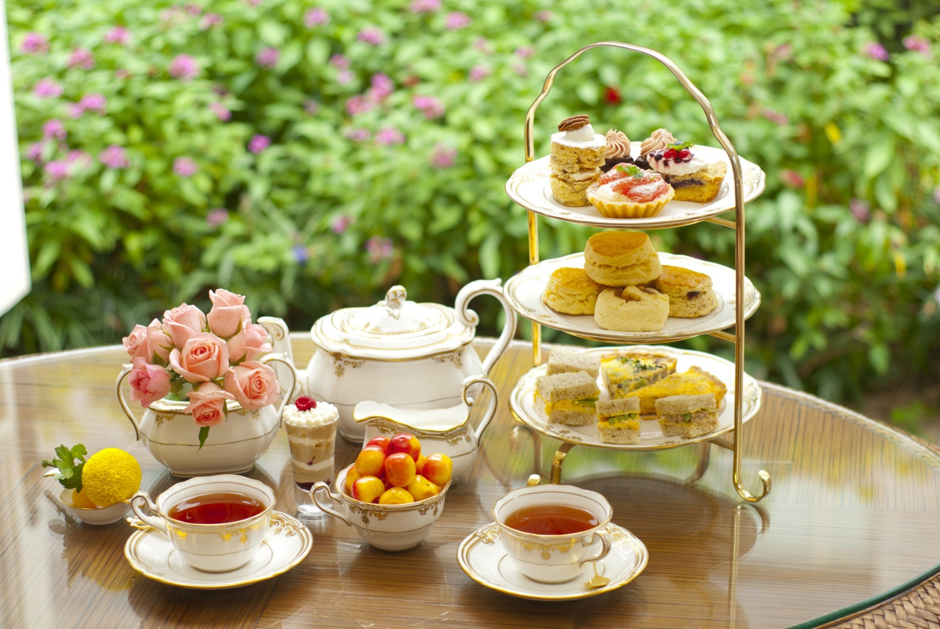
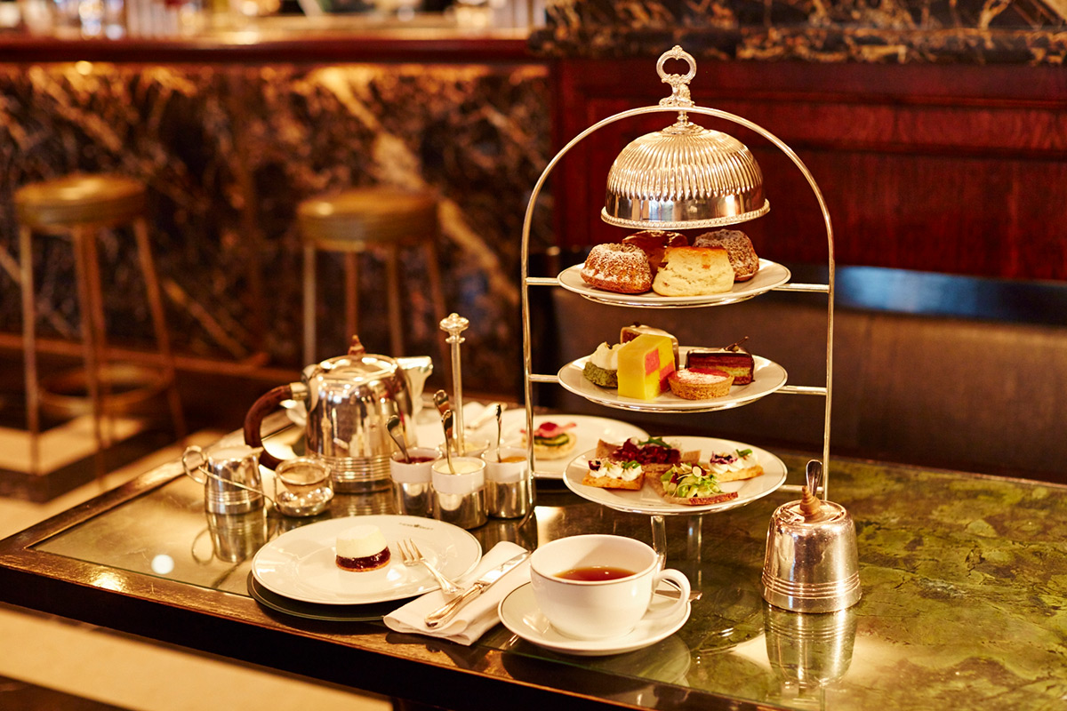
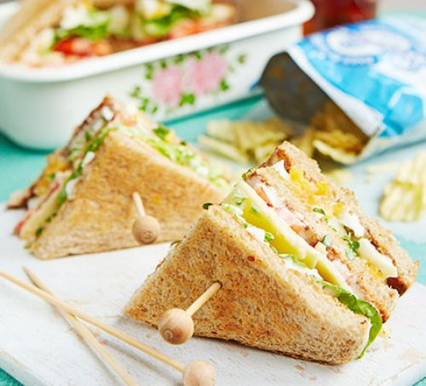
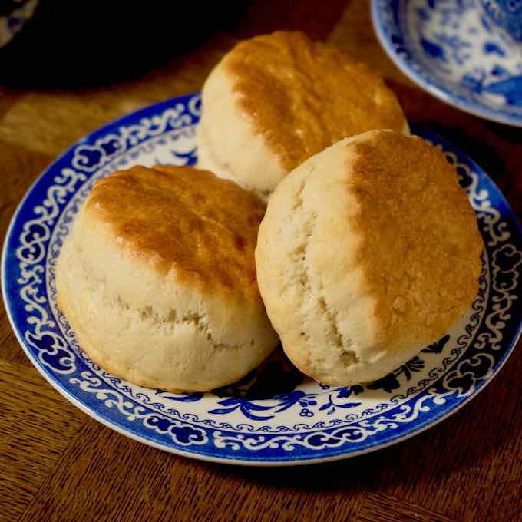
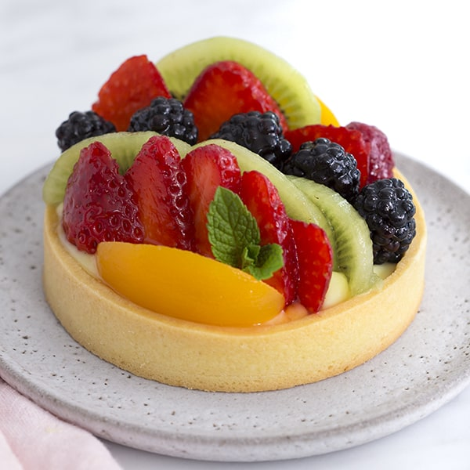
Afternoon Tea
Tea Sandwich
Scone
Fruit Tart

Slide 26
Common Sense
How to eat:
Top to botton
Salty to sweet
mild to Strong

Slide 27
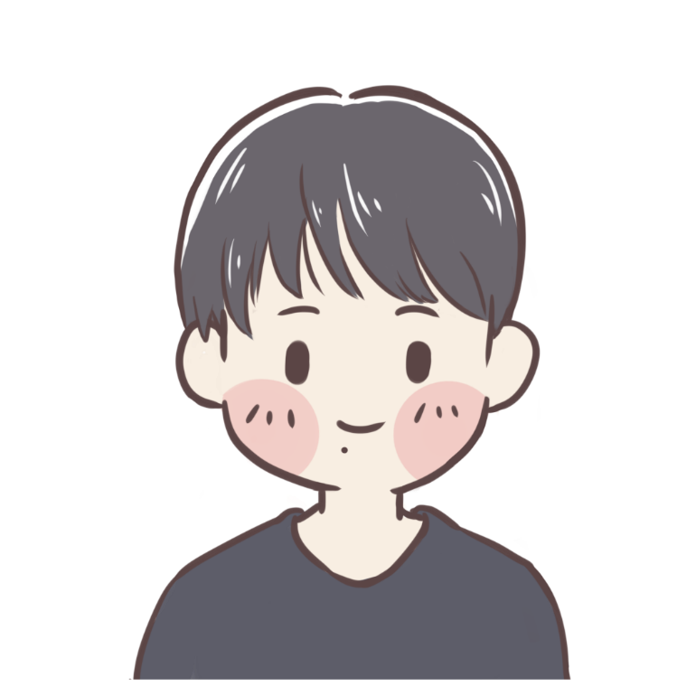

Thanks For Watching

